Slide 1
Study Design
La Jolla Work Shop
March 22, 2011

Slide 2
Issues to cover
Agree on design pattern
Address potential redundancies
Use as part of an overall investigation design

Slide 3
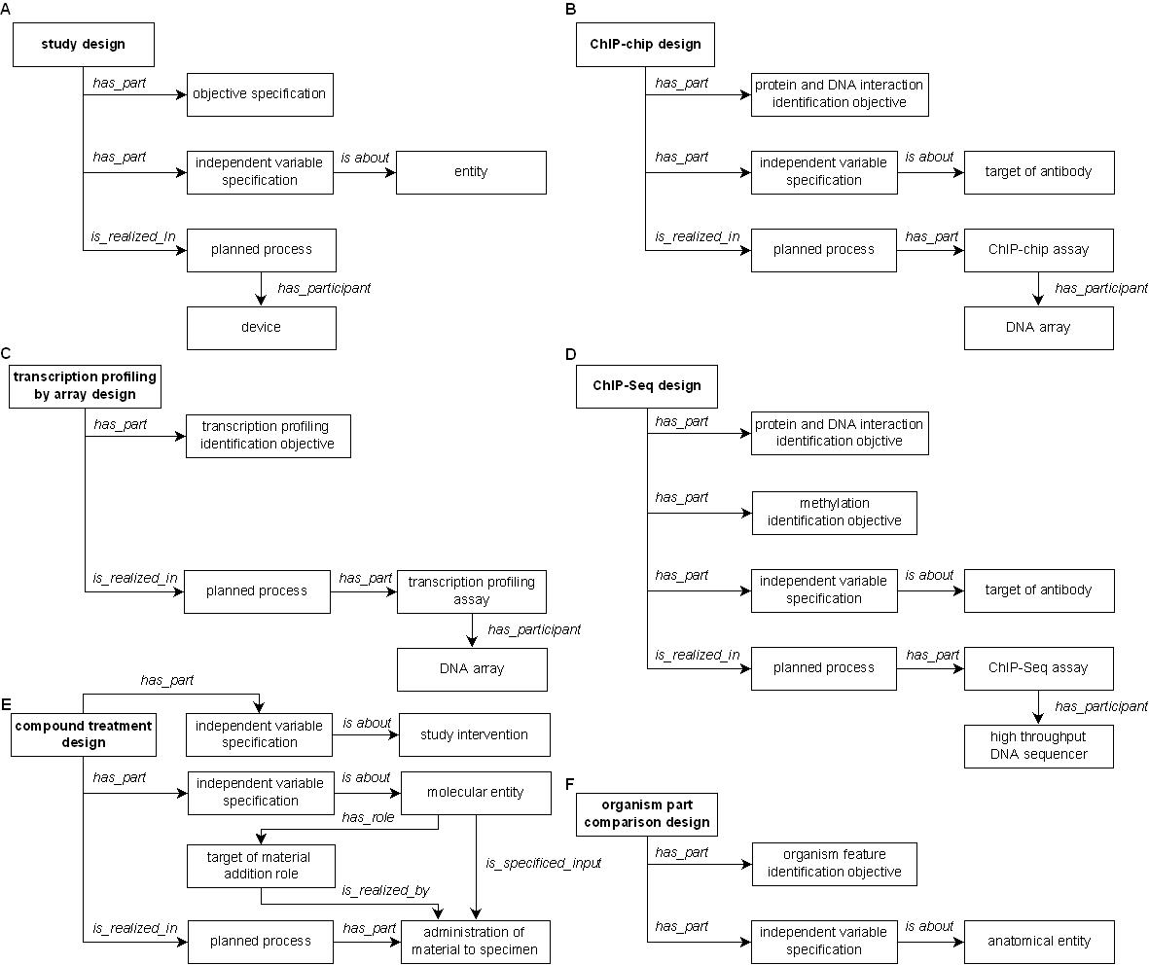
Design Pattern of Experimental Design Terms
Notes:
Bjoern: Study design that is_realized_in only (has_part some assay)
Hard to represent two relations in row, so draw planned process between two relations in the figure

Slide 4
Investigation
has planning, execution, interpreting and reporting
Study design (plan specification)
has part independent variable
has part protocol
has part objective
Assay: planned process. Material is input. Data is output.
has part protocol
has part objective
has device
? Has independent variable

Slide 5
Investigation
study plan = design : expression profiling, time course design
objective
protocols
ind. Variables: time
dep.Variable: transcript level
execution
planned process: specimen collection
assay
objective -> expression profiling
ind. Variables -> controls
protocol -> microarray hybridization
data
processed data based on ind. variables
interpretation
conclusion
evidence based on processed data

